Slide 1
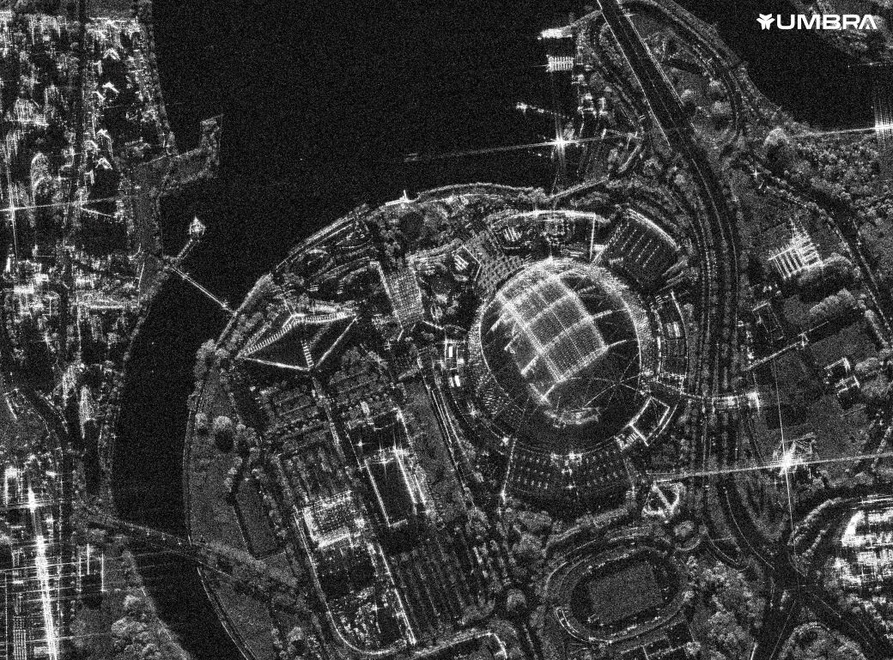
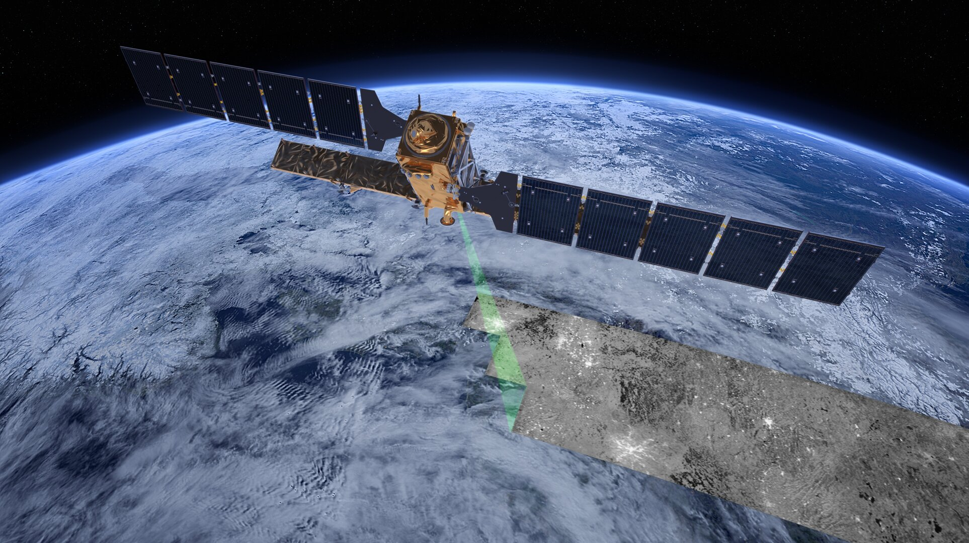
CNN Classification using SAR radar and multi-spec from satellites
28/11 Nadav Kedem

Slide 2


S-A-R
(Synthetic Aperture Radar)
Electromagnetic spectrum
SAR Frequencies

Slide 3
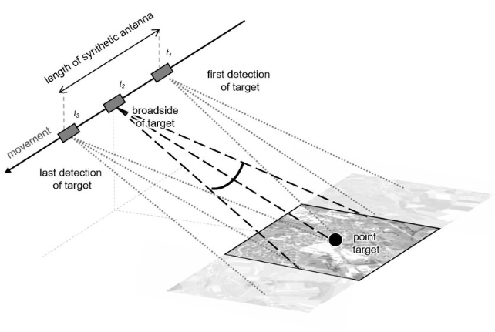
S-A-R
(Synthetic Aperture Radar)
Why use SAR?
High sensitivity to physical properties of objects
Ground Penetration capabilities (cm and sometimes a few meters)
not effected by weather conditions

Slide 4
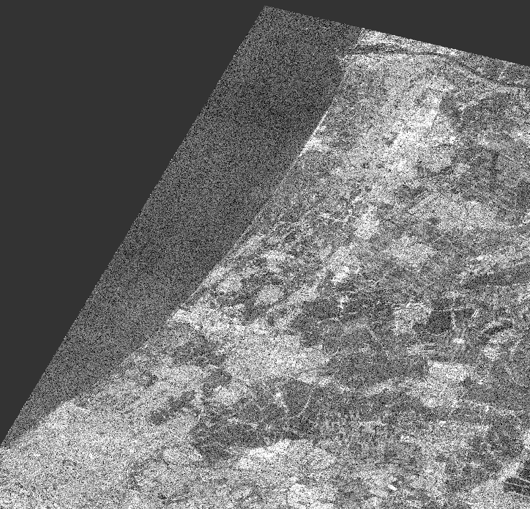
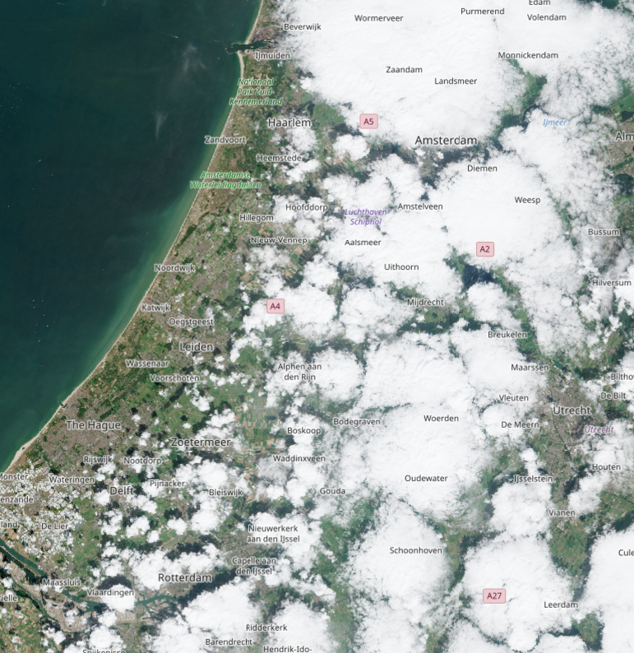
S-A-R
(Synthetic Aperture Radar)
Netherlands, Alos-2, 10/8/22
Netherlands, Sentinal-2, 10/8/22

Slide 5
S-A-R
(Synthetic Aperture Radar)
Cons:
SAR images are difficult to interpret du to
Image distortions
Radar noise interference
Limited resolution
Complex data
Netherlands, Alos-2, 10/8/22

Slide 6
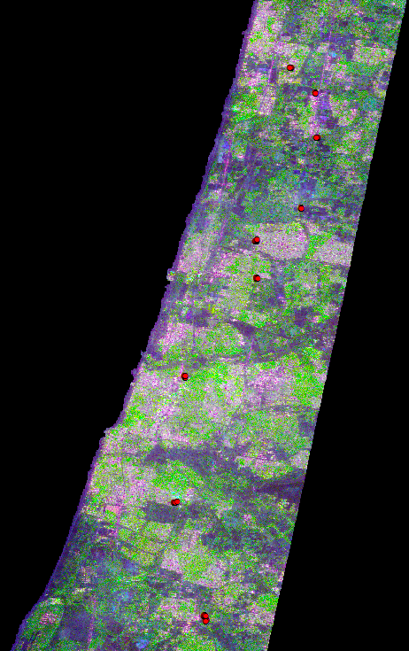
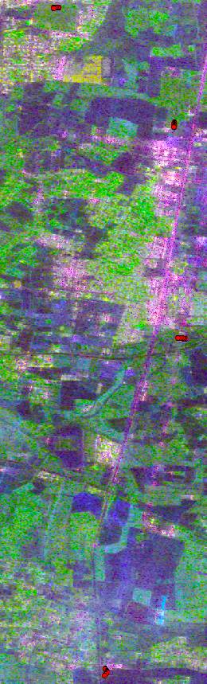
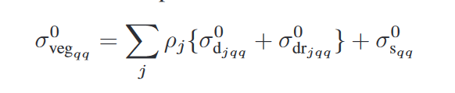
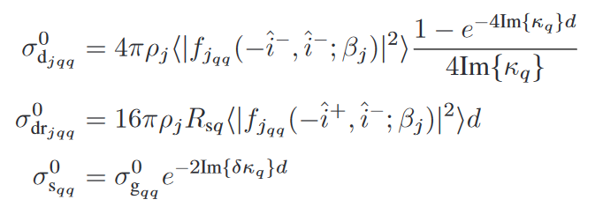
Land-Use Classification using S-A-R
Land classification from physical model:
RGB component:
-Urban
-Forst/ high-veg -Bare-soil and fields
Today the model is based on wave propagation and interaction theories
(Israel field campaign 5/2023)

Slide 7
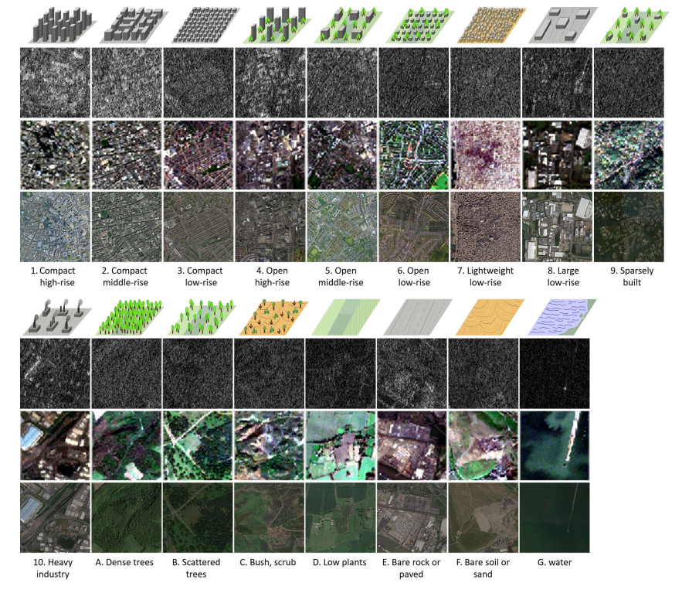
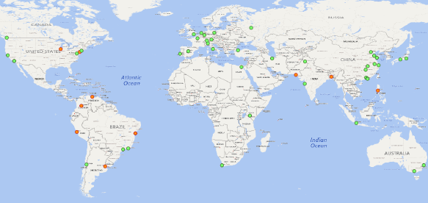
CNN for SAR and multi-spectral Classification
Obtaining the data:
From GitHub:
Large data-set of image patches from two satellites:
Sentianl-1: SAR imagery
Sentinal-2: multispectral imagery
There are over 400,000 patches of images from each satellite
Every patch has 1 of 17 possible labels representing a type of land cover.
(Xiao Xiang et al, 2015)

Slide 8
CNN for SAR and multi-spectral Classification
Labels:
Compact high-rises
Compact middle-rise
Compact low-rise
Open high-rise
Open middle-rise
Open low-rise
Lightweight low-rise
Large low-rise
Sparsely Built
Heavy Industry
Dense Trees
Scattered Trees
Bush/Scrub
Low Plants
Bare Rock or Paved
Bare Soil or Sand
Water

Slide 9
CNN for SAR and multi-spectral Classification
Data comprises of:
400,673 images patches from each satellite
Sentinal-1: (SAR radar)
32x32 pixel patches
8 dimensions:
Sentinal-2: (multi spec)
32x32 pixel patches
10 dimensions
Real part of original VH complex signal
Imaginary part of original VH complex signal
Real part of original VV complex signal
Imaginary part of original VV complex signal
Intensity of lee filtered VH signal
Intensity of lee filtered VV signal
Real part of lee filtered PolSAR covariance matrix off-diagonal element
Imaginary part of lee filtered PolSAR covariance matrix off-diagonal element
Band | Name | Wavelength
B2 | Blue | 490
B3 | Green | 560
B4 | Red | 665
B5 | Red Edge-1 | 705
B6 | Red Edge-2 | 740
B7 | Red Edge-3 | 783
B8 | NIR | 842
B8A | Narrow NIR | 865
B11 | SWIR 1 | 1610
B12 | SWIR 2 | 2190

Slide 10
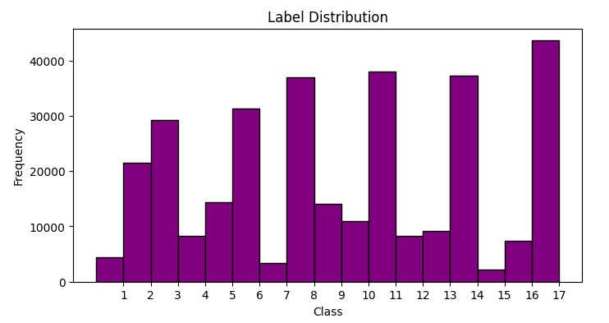
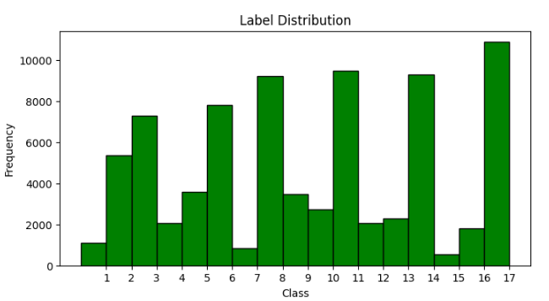
CNN for SAR and multi-spectral Classification
Data comprises of:
400,673 image patches from each satellite
Training dataset
Test dataset
Stratified Random split ~ 80/20%
320,779 patches
79,894 patches

Slide 11
CNN model Architecture – forward pass
(32x32x8)
Sentinal-1
concat
Sentinal-2
(32x32x10)
Relu
Conv-1
Relu
FC-Linear1
Conv-1
Relu
Dropout-1
FC-Dropout1
Dropout-1
Relu
Conv-2
Relu
FC-Linear2
Conv-2
Relu
Pool
FC-Dropout2
Pool
Dropout-2
FC-Linear3
Dropout-2
Flattening
Outpot
Flattening

Slide 12
CNN Model Architecture – training
#Epoches
#batches
Load one batch
Forward pass
Calc loss
Backward pass
Compute gradient
Optimizer
Update FC weights

Slide 13
CNN Model Architecture – evaluation
Test dataset
#sample
CNN model
Output - class\label
Loss
Output compared to true label
Accuracy = correct predictions/total samples
Average loss

Slide 14
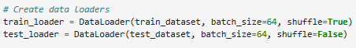
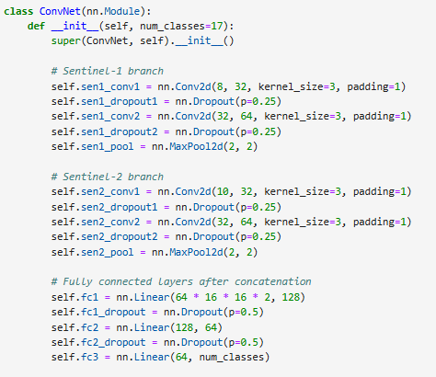
CNN model Parameters
Initial params (manual optimization):
Batch size = 64
2 convolution layers – 64 dimensions
Kernel size = 3
Padding =1
MaxPool (2,2)
Dropout rate = 0.25, 0.5
Number of Epoches = 50
Learning rate = 0.001
Constant params:
Activation func – Relu
Loss func – Cross Entropy
Optimaizer - Adam

Slide 15
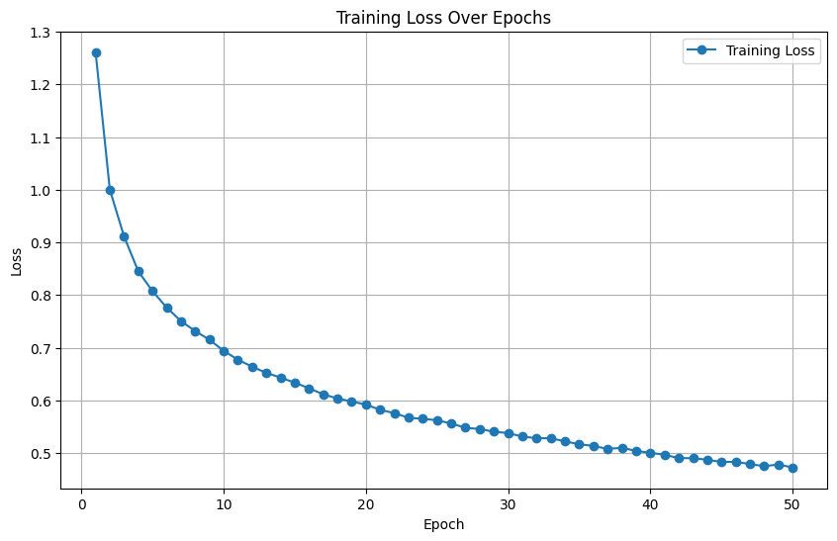
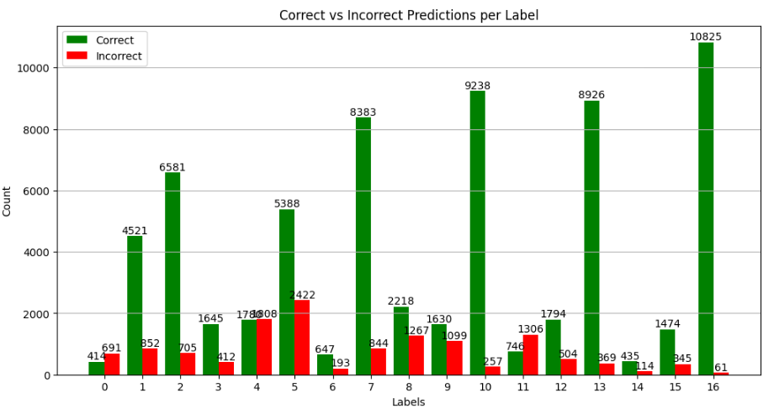
CNN Model Initial Results
Accuracy: | 0.83
Average Loss | 0.50

Slide 16
CNN Model Initial Results
Accuracy: | 0.83
Average Loss | 0.50
water
v
Bare soil
Compact buildings
More open urban area
Lightweight buildings
Large area low hight buildings\ industry
Trees, dense and sparse
Small bush and low veg
Bare rocks

Slide 17
CNN Model Initial Results
Accuracy: | 0.83
Average Loss | 0.50
water
v
Bare soil
Compact buildings
More open urban area
Lightweight buildings
Large area low hight buildings\ industry
Trees, dense and sparse
Small bush and low veg
Bare rocks

Slide 18
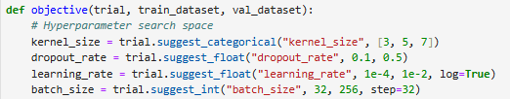
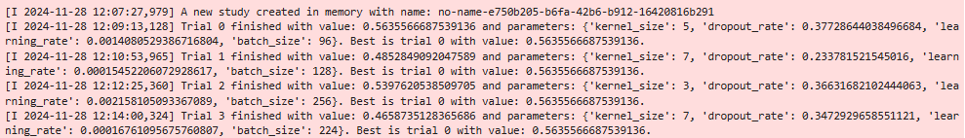
CNN Model Optimization
“optuna” Lib for parameters optimization:
Handles given parameters
Runs many small epochs with different combination of params
Uses sample dataset for fast study
Saves best performance parameters

Slide 19
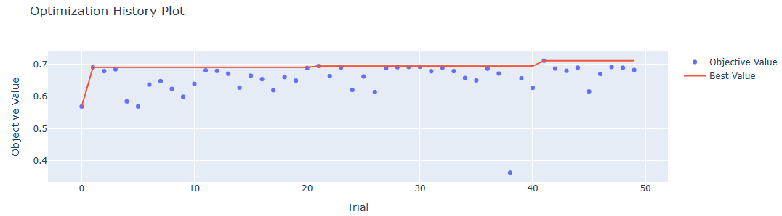
CNN Model Optimization
“optuna” Lib for parameters optimization:
Handles given parameters
Runs many small epochs with different combination of params
Uses sample dataset for fast study
Saves best performance parameters

Slide 20
CNN Model Optimization
Initial params (manual optimization):
Batch size = 64
2 convolution layers – 64 dimensions
Kernel size = 3
Padding =1
MaxPool (2,2)
Dropout rate = 0.25, 0.5
Number of Epoches = 50
Learning rate = 0.001
Optuna optimized params:
Batch size = 32
2 convolution layers – 64 dimensions
Kernel size = 7
Padding =3
MaxPool (2,2)
Dropout rate = 0.2, 0.4
Number of Epoches = 50
Learning rate = 0.004
Accuracy: | 0.83
Average Loss | 0.50
Accuracy: | 0.71
Average Loss | 0.57

Slide 21
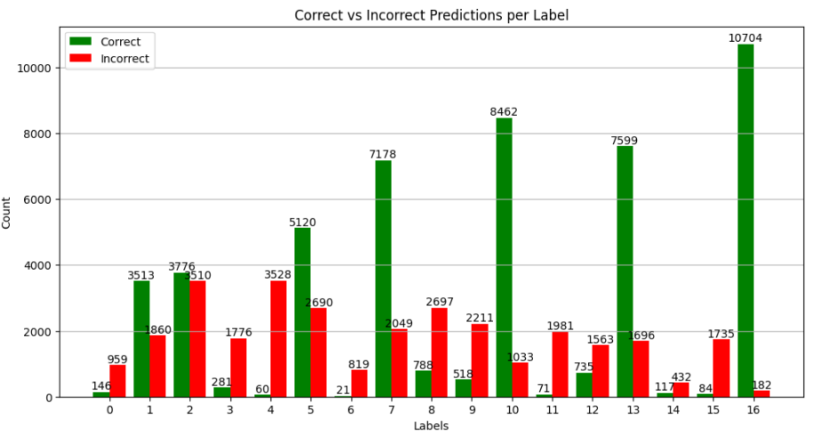
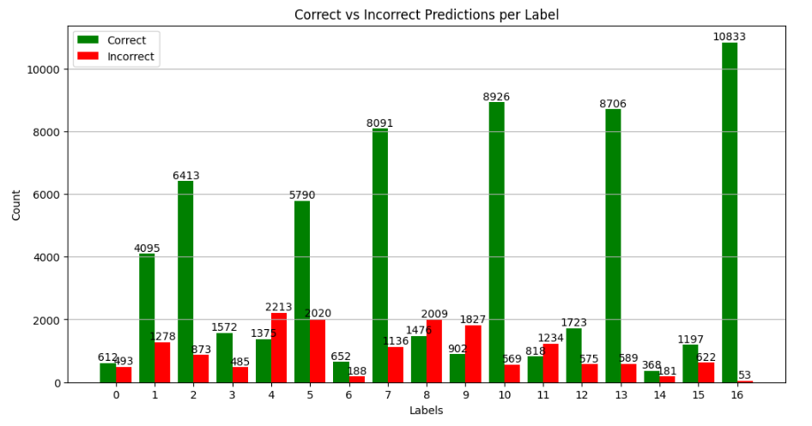
Train and Test for each satellite separately
Each satellite was given the best tested parameters for training.
Then each satellite’s images were used for train and test with a new architecture for CNN
Sentinal-1 (SAR)
Sentinal-2 (Multi)
Accuracy: | 0.62
Average Loss | 1.17
Accuracy: | 0.79
Average Loss | 0.61

Slide 22
CNN Model Merging Labels
Labels:
Compact high-rises
Compact middle-rise
Compact low-rise
Open high-rise
Open middle-rise
Open low-rise
Lightweight low-rise
Large low-rise
Sparsely Built
Heavy Industry
Dense Trees
Scattered Trees
Bush/Scrub
Low Plants
Bare Rock or Paved
Bare Soil or Sand
Water
1
2
3
4
5
6
7
8
9

Slide 23
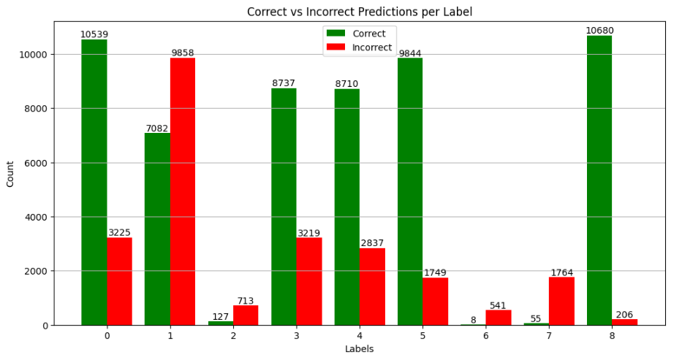
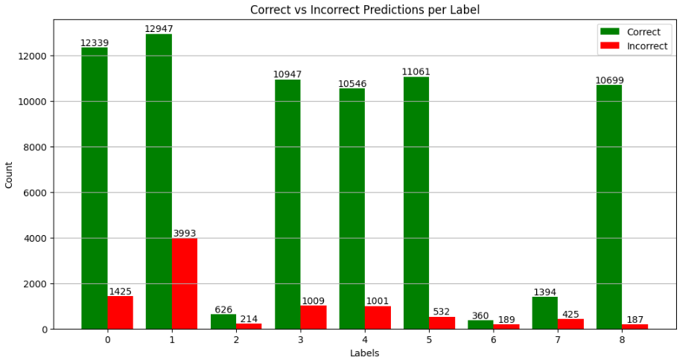
Train Test for each satellite separately
Train and test with new labels
Sentinal-1 (SAR)
Sentinal-2 (Multi)
Accuracy: | 0.62
Average Loss | 1.17
New Labels
Accuracy: | 0.70
Average Loss | 0.84
Accuracy: | 0.79
Average Loss | 0.61
New Labels
Accuracy: | 0.88
Average Loss | 0.32

Slide 24
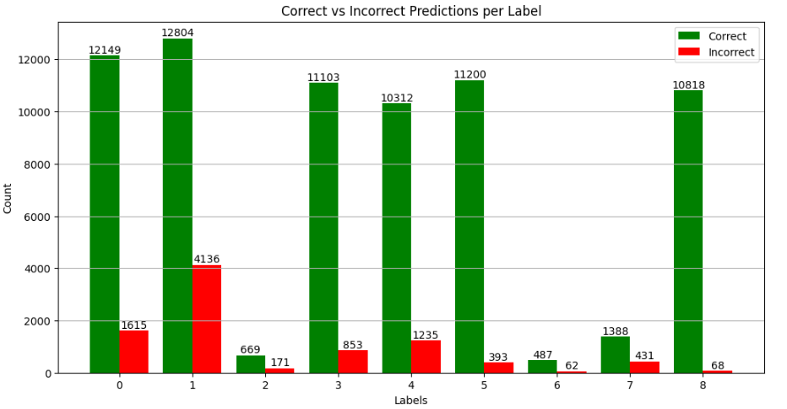
New Labels Combined Satellites
Train and test with new labels
Sentinal-1 (SAR)
Sentinal-2 (Multi)
Accuracy: | 0.83
Average Loss | 0.5
New Labels
Accuracy: | 0.89
Average Loss | 0.32

Slide 25
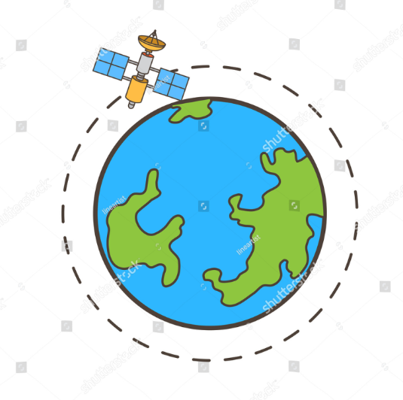
To Summarize
CNN model for land cover classification was applied using images from SAR satellite and Multi-Spec satellite
the Model yielded 89% accuracy predicting general land cover use
Using only the SAR imagery is overall less accurate especially in open urban areas
Using only Multi-spec images is practically the same as using images from both satellites
Theres probably more room for optimization:
Different activation functions
More complex architectures
Custom kernels
And that’s it!
BY BY

